Slide 1

Leveraging Retrieval-Augmented In-Context Learning For Complex Air Traffic Scenario Generation
2025
Yash Guleria, Duc-Thinh Pham, Ashton L.K. Yun, Thaivalappil N.M. Nadirsha, Katherine Fennedy, Chunyao Ma, Sameer Alam
Air Traffic Management Research Institute (ATMRI)
Nanyang Technological University, Singapore
27th June 2025

Slide 2
CONTENTS
1
2
3
4
5
SCENARIO
GENERATION
LITERATURE
METHODOLOGY
EXPERIMENTAL
DESIGN
RESULTS AND
DISCUSSIONS
Motivation and challenges
Existing methods and limitations
Language models and applicability
Proposed direction
Language model
RAG pipeline
Prompt Design
Data for RAG
Key results
Conclusions
Notes:
In this presentation, I will discuss the key idea behind scenario generation, and our motivation to pursue this research. I will shar briefly share the main methods to generate air traffic scenarios and why a new methodology may be beneficial. In the methodology, I will discuss the RAG and

Slide 3
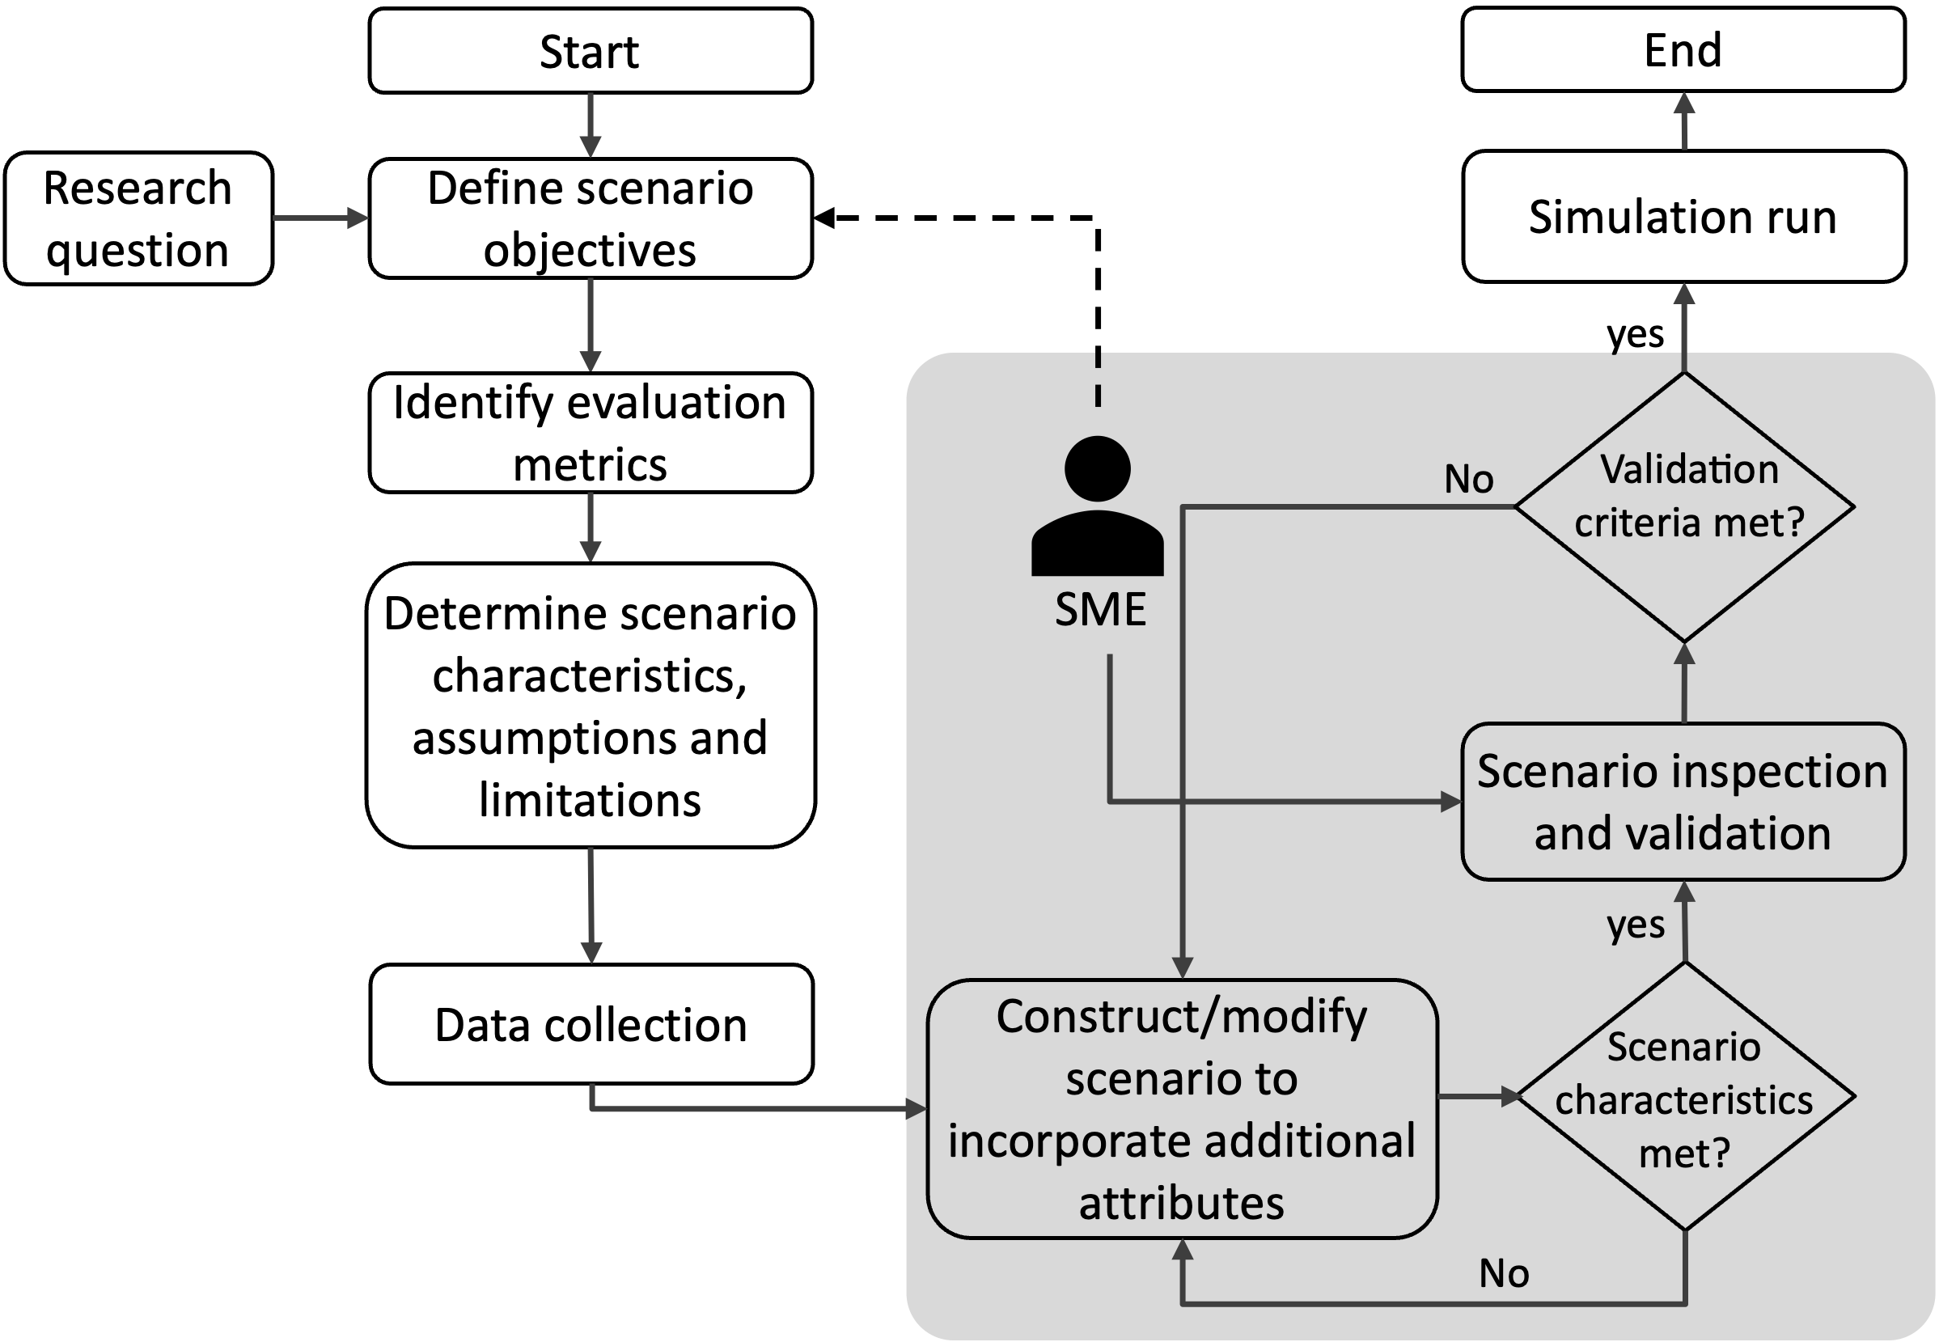
SCENARIO GENERATION
1
Motivation
Air traffic scenarios are critical enablers for:
Algorithm development and testing:
Generate controlled tests (diverse operational conditions and edge cases) for evaluating ATM algorithms.
Operational concept Evaluation:
Generate repeatable, high-fidelity tests for feasibility and safety evaluation of novel ConOps such as human-AI teaming (HAT).
Human factors research:
Performance and concept evaluation involving humans and automation systems, investigate controller situational awareness, decision-making patterns etc.
Current challenges in scenario generation:
Development bottlenecks:
Time-intensive and iterative process requiring SME-developer co-ordination.
Scale vs fidelity constraints:
High fidelity simulations limit scenario quantity and edge case converge, while large scale randomized generation may compromise operational realism.
Multi-source data integration:
Operational data is distributed across multiple heterogenous sources, making integration difficult.
Figure 1. An illustration of a typical scenario generation process involving a scenario developer and a Subject matter expert (SME), highlighting the iterative process involved in scenario generation.
Ability to systematically generate and iteratively refine air traffic scenarios challenging but critical for ATM research and development.
Notes:
Air traffic scenarios are critical enablers for numerous domain in air traffic management research such as: . ..
While the ability to generate desired scenarios is critical there are multiple bottlenecks in this process . .
Figure 1 also highlight the iterative nature of scenario generation involving a SME and a scenario developer.
As such, the ability to systematically generate and . .

Slide 4
LITERATURE
2
Scenario Generation Methodologies
Scenario Generation
Historical data
Randomized data
Manual hand-crafting
Use existing operational datasets and data patterns by altering information such as flight levels, departure times or separation parameters to create experimental scenarios.
Examples:
Research on continuous descent operations, arrival sequencing [16], and demand-capacity balancing [17].
Constrained by original data distributions that are prone to replicating existing data patterns.
Use probabilistic distributions for key parameters( traffic density, aircraft types, routing structures) to generate novel traffic behaviors.
Typically used where data is scarce/unavailable.
Examples:
Conflict detection and resolution studies.
Novel operational paradigms, such as free route airspace (FRA) [13] and flow-centric operations [14].
Ensuring generated data quality and its distribution remains challenging.
Manual data generation from scratch.
Examples:
Human-in-the-loop (HITL) experiments to investigate workload, decision-making patterns etc.
Tasks demanding specific characteristics.
Significantly time consuming, poor scalability (often limited to few bespoke scenarios).

Slide 5
LITERATURE
2
LLMs and their Applicability
Air Traffic Management Use case (Text-To-Text):
Challenges when considering LLMs:
Q&A, Summarization tasks – AviationGPT (2024)
Ground delay program (GDP) information management (summarization) – ChatATC (2024)
Aviation safety Analysis and incident reporting system (report analysis) - ASRS (2023)
LLMs are fundamentally designed for unstructured output.
Scenario generation involves generating structured outputs, which is difficult for language model (at-least small scale).
Fine-tuning is not feasible due to scale/ unavailability of data.
Notes:
Before diving into our methodology, let's look at how Large Language Models are currently being applied in aviation (specifically text-to-text). AviationGPT represents a comprehensive approach to aviation-domain LLMs, showing significant performance gains across multiple aviation text processing tasks,
ChatATC demonstrates practical LLM deployment in air traffic management, processing decades of operational data to assist with strategic decision-making,
The ASRS work shows LLMs can effectively process aviation safety data and identify patterns in incident reports, proving valuable for safety analysis but again operating in the text analysis domain rather than structured scenario generation.

Slide 6

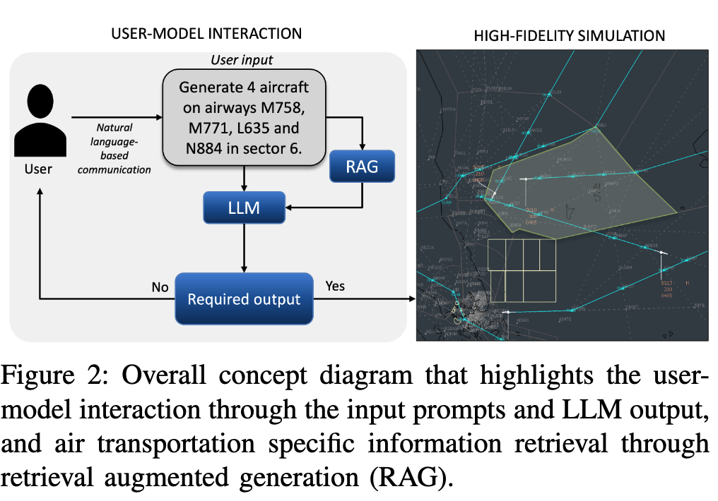
LITERATURE
2
Proposed Direction
Leverage LLMs with Retrieval-Augmented Generation (RAG).
Advantages:
Natural language-driven scenario creation:
Conversation style user instructions
Iterative, user-guided customization:
Access to session’s conversation history, similar to commercial models.
Generation of high-fidelity air traffic scenarios:
Scenarios used for simulation is NARSIM
Figure 2: Overall concept diagram that highlights the user-model interaction through input prompts and LLM output, and sector and airway specific information retrieval through RAG.
Notes:
Overall idea behind RAG what governs the context length of the LLMs?

Slide 7
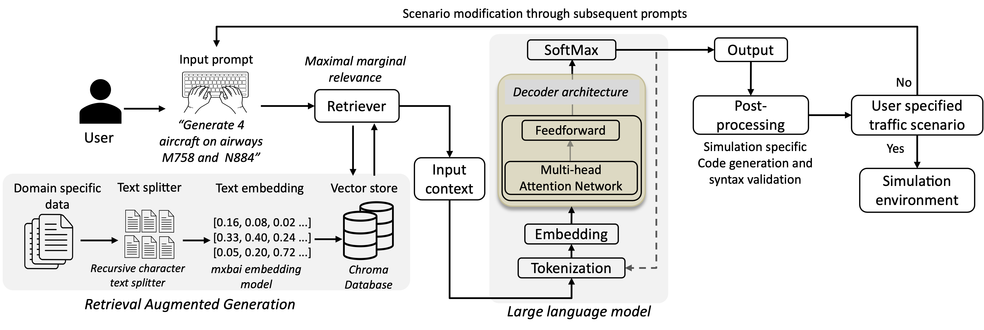
OVERALL METHODOLOGY
3
Components
Language model – Cohere’s Command R
Retrieval system
Figure 3: The proposed methodology employs Retrieval-Augmented Generation (RAG) to extract sector specific information—airways, waypoints, and aircraft types from domain-specific documents, facilitating tailored air traffic scenarios generation.
Notes:
What does 35 b parameters mean?
The architecture is although a decoder only- (why this), we do not know what is the exact network structure.

Slide 8
OVERALL METHODOLOGY
3
Language Model
Conventional decoder-only model.
35 billion parameters.
Long-context (144k tokens) processing and efficiency in retrieval-augmented generation (RAG) and multi-turn conversation.
Avoids ‘lost in the middle’ phenomenon.
Figure 4: A high-level architecture of the language model.
Notes:
What does 35 b parameters mean?
The architecture is although a decoder only- (why this), we do not know what is the exact network structure: Autoregressive generation: Perfect for next-token prediction - the core LLM task. We can achieve performance with relatively lesser model size (since no encoder parameters to tune)

Slide 9
OVERALL METHODOLOGY
3
RAG
Retrieval Augmented Generation (RAG):
Adapting the ‘generalized’ LLMs to specific use cases.
While the models can be fine-tuned, data is scarce, and fine tuning is computationally expensive.
RAG, by contrast, allows an LLM to retrieve and incorporate external domain-specific knowledge without modifying its underlying parameter.
Helpful in reducing model hallucinations to some extent.
Ability to keep models up-to-date and domain customized.
Figure 5: The retrieval-augmented generation (RAG) pipeline. The input text is split into suitable chunks based on selected hyperparameters. Based on the similarity with the input prompt, a fixed number of closely related chunk are extracted from the vector store.

Slide 10



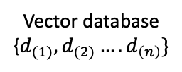
OVERALL METHODOLOGY
3
RAG
Key steps in a retrieval pipeline:
Domain specific data
Text splitter
Text embedding
[0.16, 0.08, 0.02 ...]
[0.33, 0.40, 0.24 ...]
[0.05, 0.20, 0.72 ...]
Vector database
{$d_{(1)},d_{(2)}….d_{\left(n\right)}\}$
Recursive character text splitter
Hyperparameters: chunk size and overlap
Mxbai-embed-large-V1 model
System message
+
Chat history
+
Current query and retrieved information
Embedded vector, q_{i}
Top k chunks
User query
Embedding model
Similarity search
Input to LLM
Generate 7 aircraft in sector 6. 4 aircraft should be A333
on airway L635 separated by 200 seconds starting a time 200. 3 aircraft should be B737 on airway N884 and separated by 100 seconds starting at time 0.
Mxbai-embed-large-V1:
A sentence embedding model.
Embeds sentences or short passages into 512-dimentional dense vectors.
Example: [0.234, -0.567, 0.891, 0.321,-0.123 ...]
Cosine similarity with
Maximal marginal retrieval
λ = 0.6 (relevance vs diversity balance)

Slide 11
OVERALL METHODOLOGY
3
RAG
Hyper Parameters:
Chunk size (500): maximum size of a chunk of text (characters)
Chunk overleap (100): Target overlap between chunks.
Overlapping chunks help to mitigate loss of information when context is divided between chunks.
Context fragmentation: important information split across multiple chunks.
Single chunks don’t contain enough information to be meaningful
Chunk size = 500
Chunk size = 200
Chunk 0: Airways in Sector 6
1. Airway M758
{
"time": "Initialization time of aircraft after simulation start in seconds",
"type": "A320",
"departure": {
"af": "WMKK"
},
"initial_position": {
"latitude": "032432.00N ",
"longitude": "1035544.00E ",
"altitude": "FL370",
"heading": "87.11"
},
"air_route": [ "IDSEL", "URIGO", "VISAT", "MABAL", "ELGOR", "OPULA", "LUSMO" ],
"destination": {
"af": "WBKK"
}
}
Chunk 0: Airways in Sector 6
1. Airway M758
{
"time": "Initialization time of aircraft after simulation start in seconds",
"type": "A320",
"departure": {
"af": "WMKK"
},
"initial_position": {
-------------------------------------------------------------------------------------------
Chunk 1: "type": "A320",
"departure": {
"af": "WMKK"
},
"initial_position": {
"latitude": "032432.00N ",
"longitude": "1035544.00E ",
"altitude": "FL370",
"heading": "87.11”
-------------------------------------------------------------------------------------------
Chunk 2: "longitude": "1035544.00E ",
. . . ..
Figure 6: representation of different chunk size values and the generated output.

Slide 12
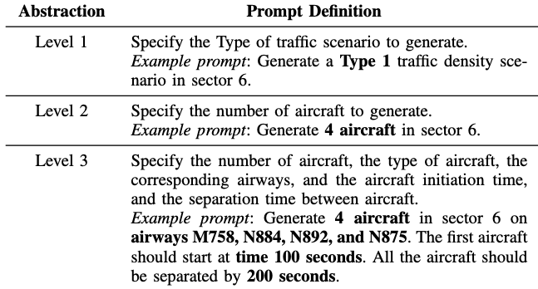
EXPERIMENTAL DESIGN
4
Prompt Design
Different abstractions to allow varying degrees of details and ease of generation.
Prompt design
Level of detail
Distinct traffic densities
Level 1
Level 2
Level 3
Type 1
Type 2
Type 3
1-4 aircraft
5-9 aircraft
10-20 aircraft
Based on extent of details to be provided.
For randomized scenario generation
Customizable traffic scenario features:
Number of aircraft
Type of aircraft
Start times of the aircraft
Separation between aircraft
Airways
Initial and final flight levels of the aircraft

Slide 13
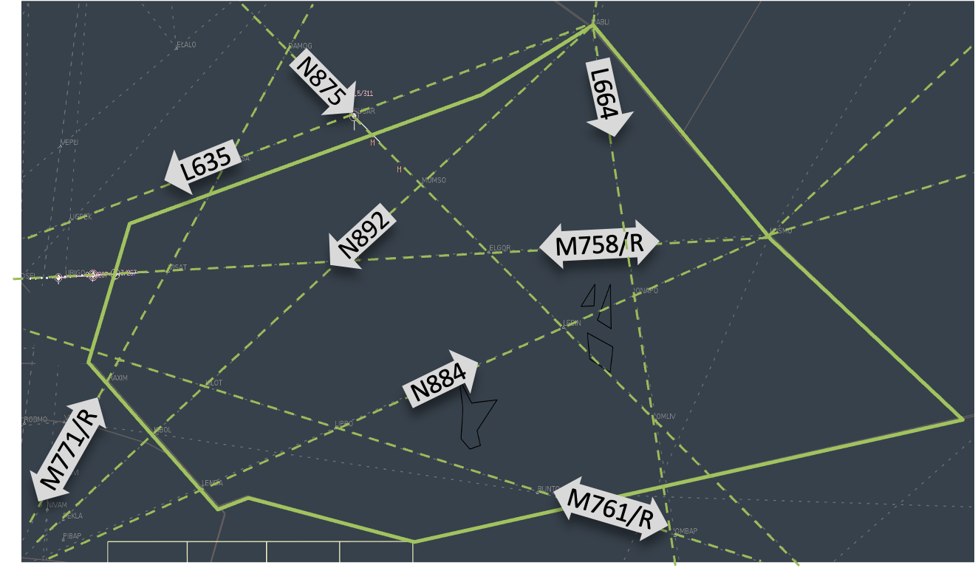
EXPERIMENTAL DESIGN
4
Data Preparation for RAG
Information in the RAG document:
Airway information in the concerned sector
Initial positions (spawn points) and headings of the aircraft
Origin/destination airport pairs.
List of waypoints and their coordinates.
Initial and final flight levels of the aircraft
1. Airway M758
{
"time": "Initialization time of aircraft after simulation start in seconds",
"type": "A320",
"departure": {
"af": "WMKK"
},
"initial_position": {
"latitude": "032432.00N ",
"longitude": "1035544.00E ",
"altitude": "FL370",
"heading": "87.11"
},
"air_route": [ "IDSEL", "URIGO", "VISAT", "MABAL", "ELGOR", "OPULA", "LUSMO" ],
"destination": {
"af": "WBKK"
}
}
Figure 8: Information of Airway M758 as in the document used in RAG.
Figure 7: Sector 6 and the corresponding airways that were included in the RAG document. The arrows indicate the airway direction.
Notes:
Considering the operational constraints of airways, their direction

Slide 14
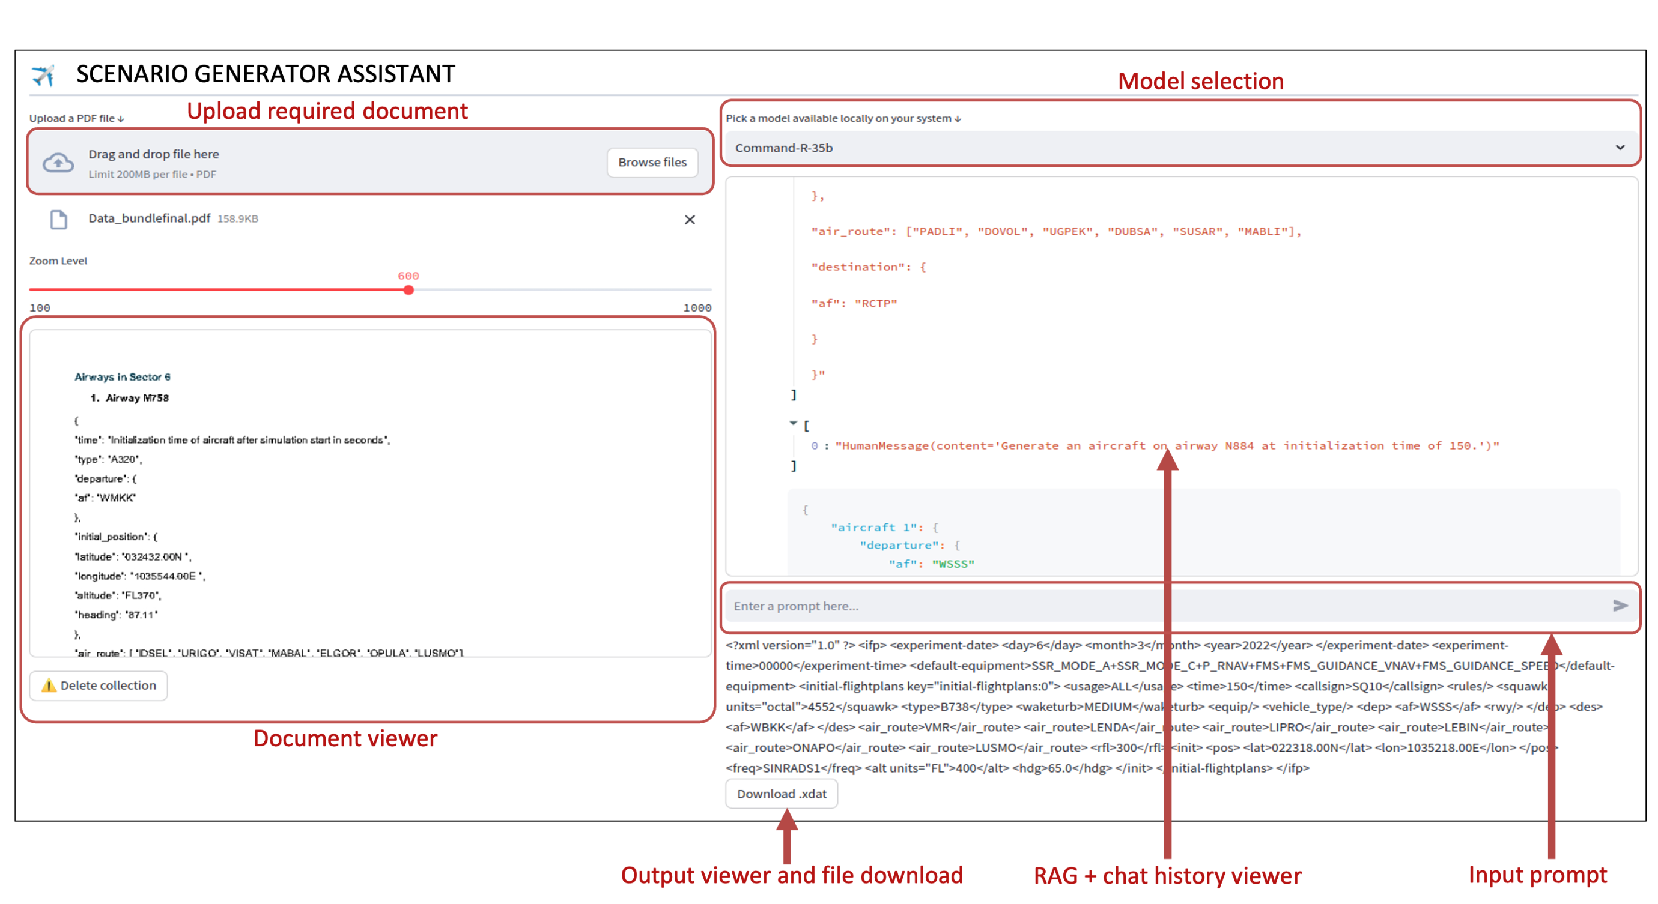
EXPERIMENTAL DESIGN
4
Visual Interface
Upload and view the document
Model Selection
Chat History
Output file view and download
Figure 9: An interactive interface developed to enable seamless user interaction with the scenario generation model. The interface
allows for document upload, model selection, prompt input, RAG data and chat history visualization and output file download.

Slide 15
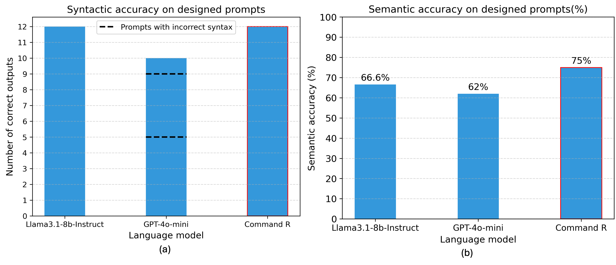
RESULTS
5
Model Performance Comparison
Models compared: Llama3.1-8b-Instruct, Cohere Command-R-35b, GPT-4o-mini
Metrics:
Syntactic accuracy: Correctness of the generated output file for the simulation environment.
Semantic accuracy: Adherence with the user’s input prompts in terms of specified features and constraints.
A set of 22 prompts covering different traffic density types and abstraction levels.
Figure 10: Model performance comparison for syntactic accuracy (a) and semantic accuracy (b) for a list of curated prompts. The dashed lines indicate the prompts where the models generated partially or completely incorrect outputs.
Notes:
Llama, gpt: Type Traffic Misinterpretation: Failed to correctly interpret "Type 2" and "Type 3" traffic (interpreted as 2 and 3 aircraft instead of traffic density ranges)
Issues with high traffic density (10+), failed to generate all.
Incorrect aircraft distribution on the required airways.

Slide 16
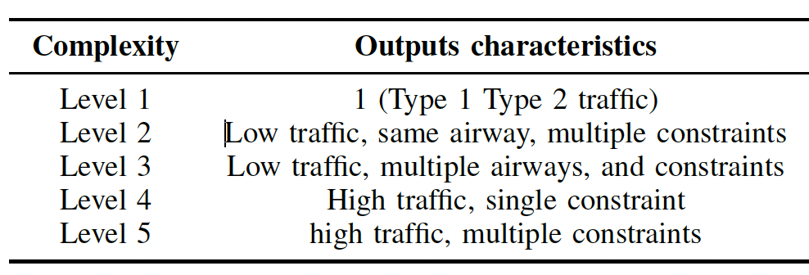
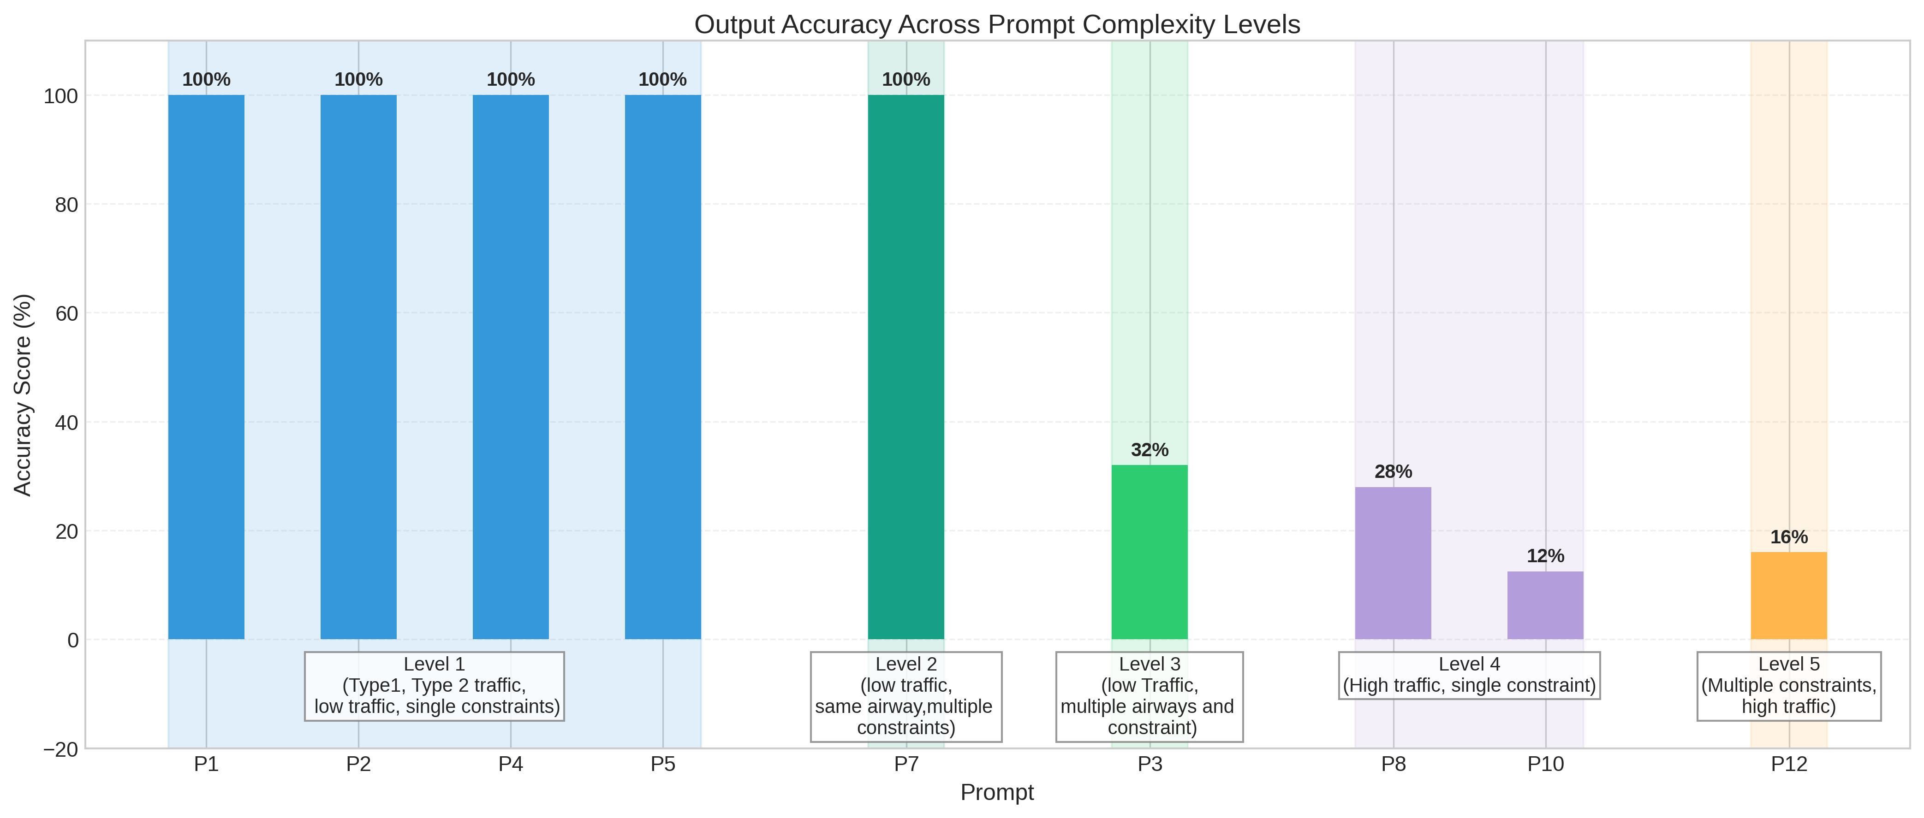
RESULTS
5
Model Limitations (Command R: Single Prompts)
Prompts categorized into 5 levels:
Each prompt run for 50 iterations to evaluate output consistency
Key limitations:
Unable to capture all components of a complex/details prompts (multiple aircraft, multiple airways and constraints) in a single prompt.
Most common error: incomplete airways
Mis-interpretation of bi-directional airways: M758/M758R, M771/M771R.
Figure 11: Consistency of Command R in generating correct outputs across different complexity levels. Typically, constraints involving relatively longer outputs and diverse constraints affect the model performance negatively.
Notes:
Why such drastic drop ( but why should I expect a proportional drop or a gradual drop- but – potentially due to 1. the transition between levels is not

Slide 17
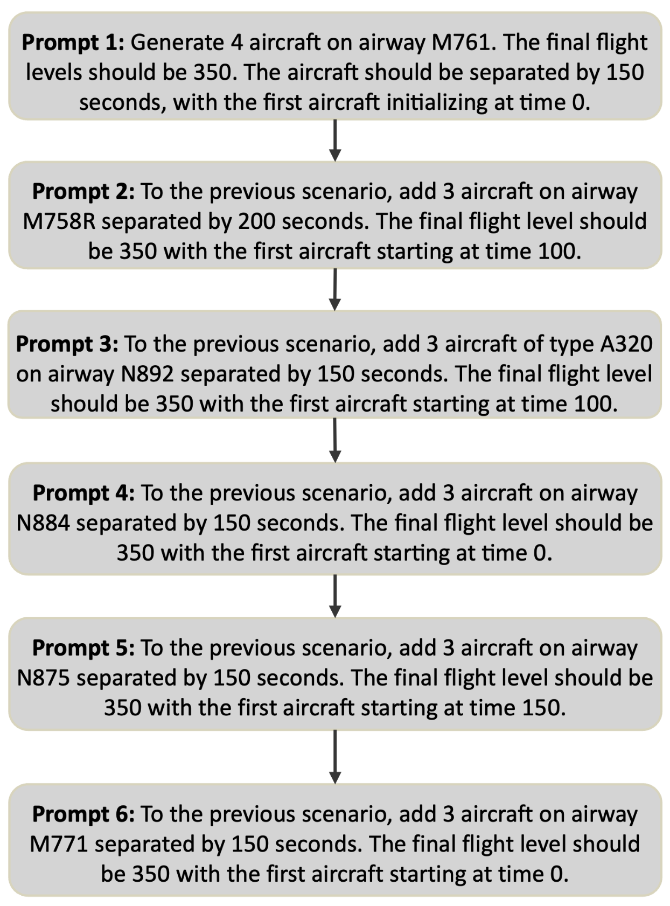
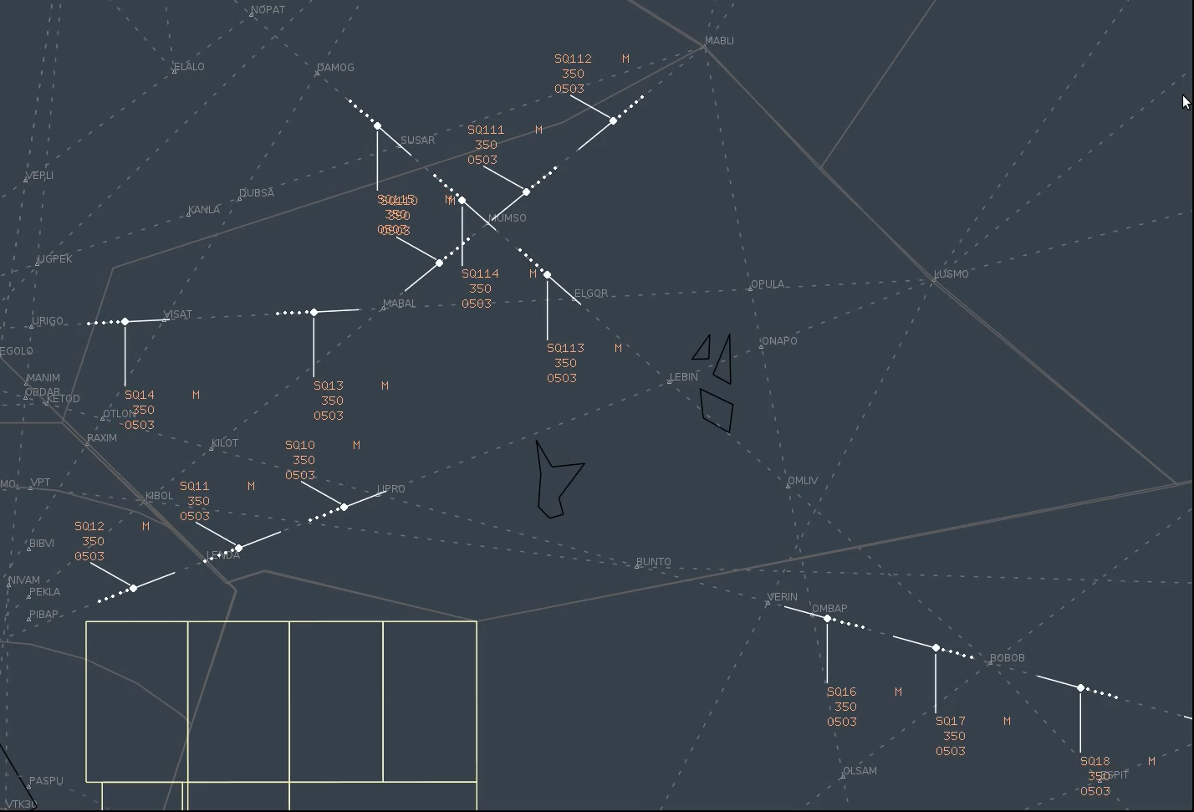
RESULTS
5
Scenario Customization with Sequential Prompts
Allows for iterative customization of scenarios through access to the conversation history.
Enables traffic dense scenario generation.
Figure 12: A demonstration of complex air traffic scenario generation through sequential prompt to the model, Command R.

Slide 18
CONCLUSIONS
6
summary
Future work
RAG supported LLM methodology streamlines air traffic scenario generation.
Command R demonstrate 100% syntactical accuracy and the highest semantic accuracy in scenario generation.
The methodology enable iterative customization for complex scenario generation.
Limitations:
Generating complex scenario with high traffic densities and multiple constraints in single prompts not feasible currently (attributed to model size).
Errors such as incomplete airways and misinterpretation of bi-directional airways exist.
Conflict scenario generation: investigate architectures to generate complex air traffic conflict scenarios.
Incorporation of operational data to generate more realistic scenarios (reviewer’s comment).

